Slide 1

ESTIMATION OF WINE QUALITY USING CHEMICAL ANALYSIS DATA

Slide 2

OUR TEAM:
Jacindha
Hymadevi
Saikumar
Nandhini

Slide 3

ABSTRACT:
The price of wine is based on the quality which is determined by its composition. Each type of wine has its own composition. Hence our idea is to use the type ,acidity, alcohol content and other chemical factors to determine the quality and hence price of the wine. The customer can choose the type of wine by his financial status.

Slide 4
OBJECTIVE:
To build a model where it can estimate the quality of wine which varies by its composition and chemical factors .
To predict the price of wine based on the sensory points
To visualize over analysis so that the customer can choose the type of wine which he can afford.

Slide 5
RELATED WORKS:
Ian Xiao has done chemical analysis on Red wine and White wine and differentiated the high quality and low quality based on attributes like fixed acidity,volatile acidity,residual sugar,chlorides,alcochol,Sulphur dioxide,density,pH and sulphates and sensory data.
Helene Hopfer .et al has done study on, the sensory, volatile and elemental profiles of 27 Californian Cabernet Sauvignon wines were correlated to the quality proxies (i) points awarded during a wine competition, (ii) wine expert liking scores, (iii) retail bottle price, (iv) vintage, and (v) wine region.

Slide 6
LIMITATIONS:
No single compound or sensory descriptor is able to fully describe all aspects of wine quality.
No standard method is used to determine the quality and calculate the price.

Slide 7
PROPOSED SYSTEM:
Predict the price of the wine by training the known price-quality points datasets.
Train a model using all attributes: fixed acidity, volatile acidity, citric acid, residual sugar, chlorides, free sulfur dioxide, total sulfur dioxide, density, pH, sulphates, alcohol to estimate the wine quality and hence predict the accurate price.
Analyze the price derived from quality score and the model defined by us.

Slide 8
DIFFERENT TYPES OF WINE:
RED WINE TYPES:
WHITE WINE TYPES:
Aglianico
Alicante
Baco Noir
Barbera
Cabernet Franc
Cabernet sauvignon
Pinot noir
Syrah
Merlot
Malbec
Barbera
Chardonnay
Kerner
Malvasia
Moscato
Pinot Gris
Riesling
Semillon
Sercial
Welschriesling
Viognier

Slide 9
OUR MODEL:
PREVIOUS MODEL
PROPOSED MODEL
LINEAR
REGRESSION
SENSORY POINTS
RANDOM
FOREST
PRICE OF WINE
CHEMICAL ATTRIBUTES:
QUALITY
(0-10)
1.Fixed acidity
2.Volatile acidity
3.Citric acid
4.Residual sugar
5.Chlorides
6.Freesulfardioxide
7.totalsulfardioxide
8.Density
9.pH
10.Sulphates
11.Alcohol
SCALING
QUALITY
(0-100)POINTS
LINEAR
REGRESSION
DETERMINE THE PRICE

Slide 10
LIST OF MODULES:
Analysis of wine chemical dataset
Analysis of wine review dataset
Predicting the price of wine based on sensory points
Estimation of quality based on chemical properties
Determining the price of the estimated quality

Slide 11
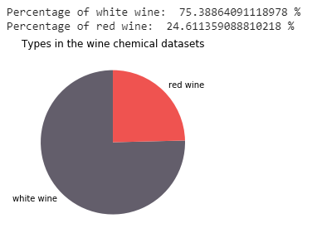
VISUALIZATIONS IN DATASET:

Slide 12
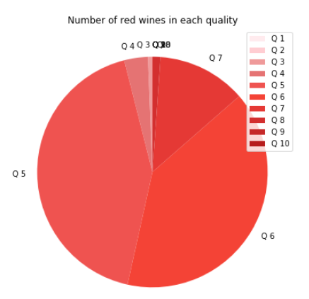
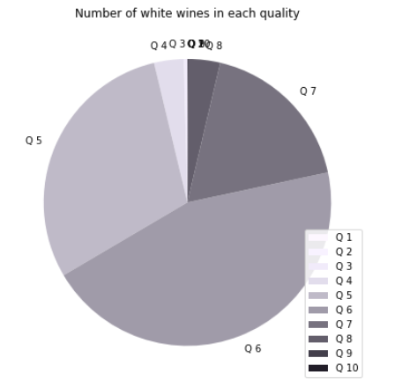
NUMBER OF WINES IN EACH SENSORY POINTS(1-10)

Slide 13
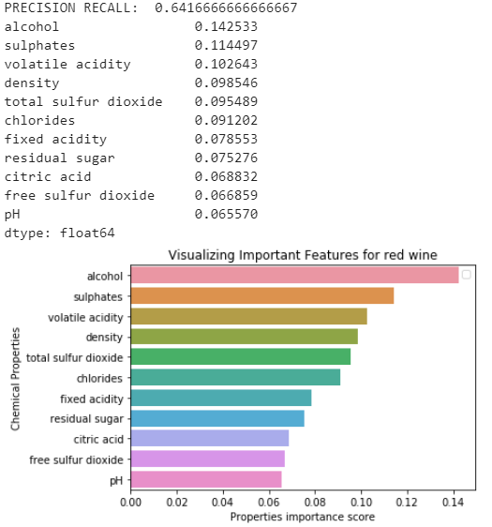
VISUALIZATIONS OF CHEMICAL FEATURES OF RED WINE:

Slide 14
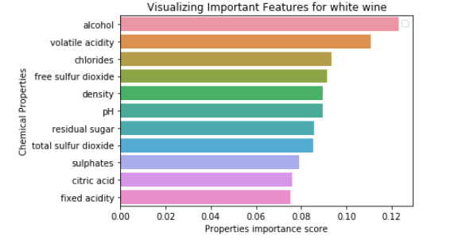
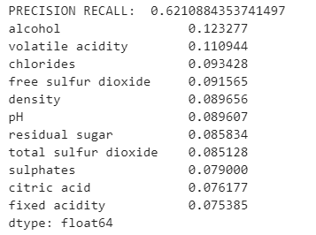
VISUALIZATIONS OF CHEMICAL FEATURES OF WHITE WINE:

Slide 15
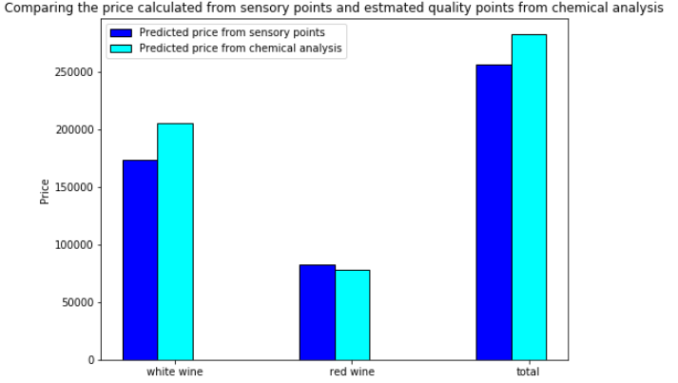
PERFORMANCE EVALUATION:

Slide 16
CONCLUSION:
Sensory points are awarded by tasting the wine. This is not standard and will vary among many tasters. Hence estimating its quality from the sensory points is not accurate.
Our method estimates the quality from the chemical properties, which even the computer can calculate.The price can be changed according to the winery, if they can train the computer with their own quality vs price datasets.

Slide 17
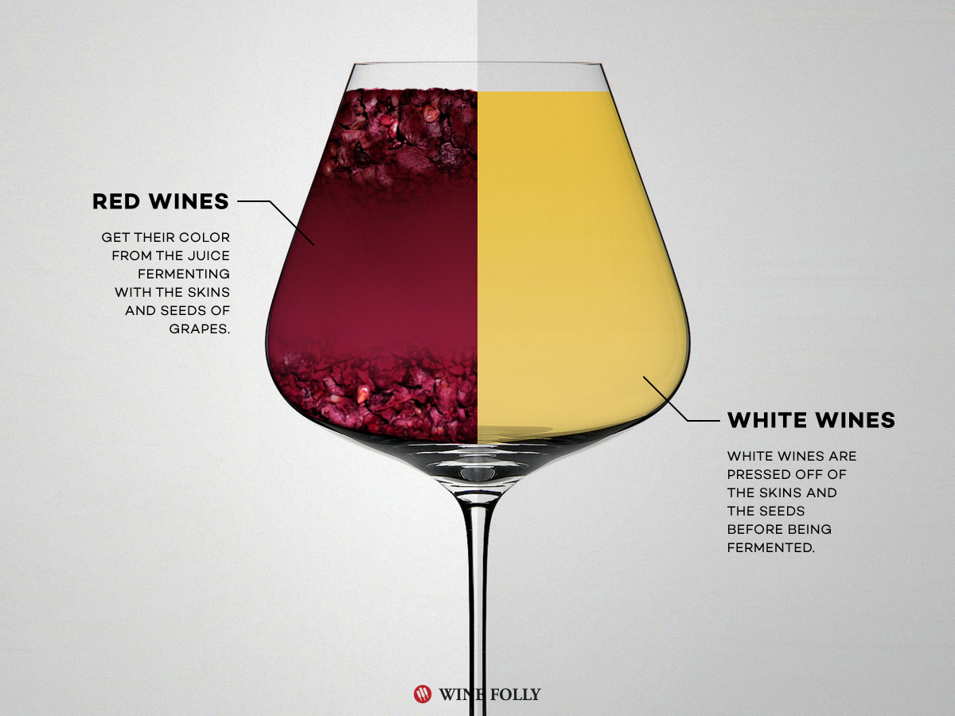
REFERENCES:
Red and White Wine Analysis by Ian Xiao dated June 27, 2015(https://rstudio-pubs-static.s3.amazonaws.com/98369_7d87780667b74901af21ff93c1c1e1db.html)
Molecules 2015, 20 ,Correlating Wine Quality Indicators to Chemical and Sensory Measurements by Helene Hopfer ,Jenny Nelson,Susan E. Ebeler and Hildegarde Heymann

Slide 18
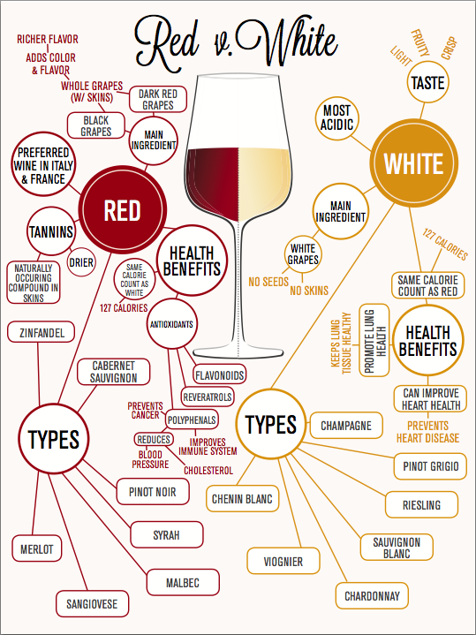
REFERENCES FOR WINE VARIETIES
List of White Wine Varieties from:http://frenchscout.com/white-wine-varietals
List of Red Wine Varieties from:http://frenchscout.com/red-wine-varietals
-BY ESTELLE PLATINI

Slide 19
THANK YOU

